Slide 1

Slowing the Spread of COVID-19
Part 2 of 3: Contact Tracing 101
May 21, 2020

Slide 2
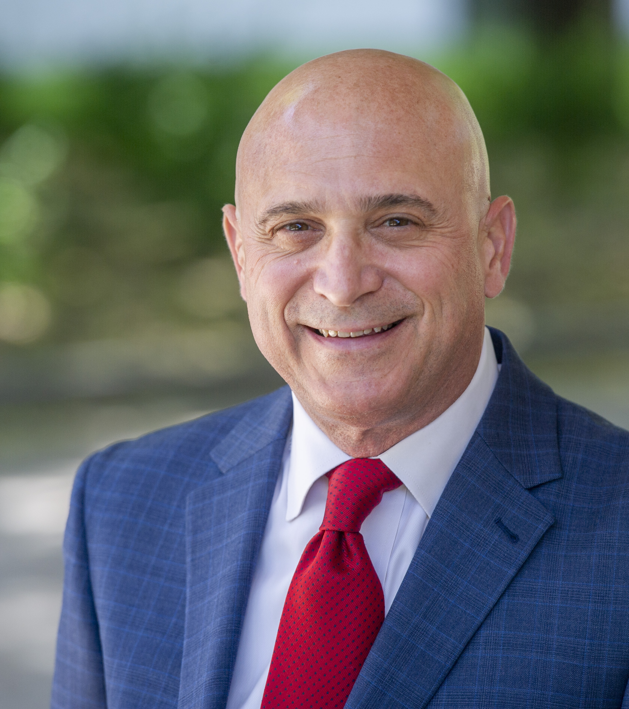
Stephen J . Acquario
Executive Director
NYSAC

Slide 3
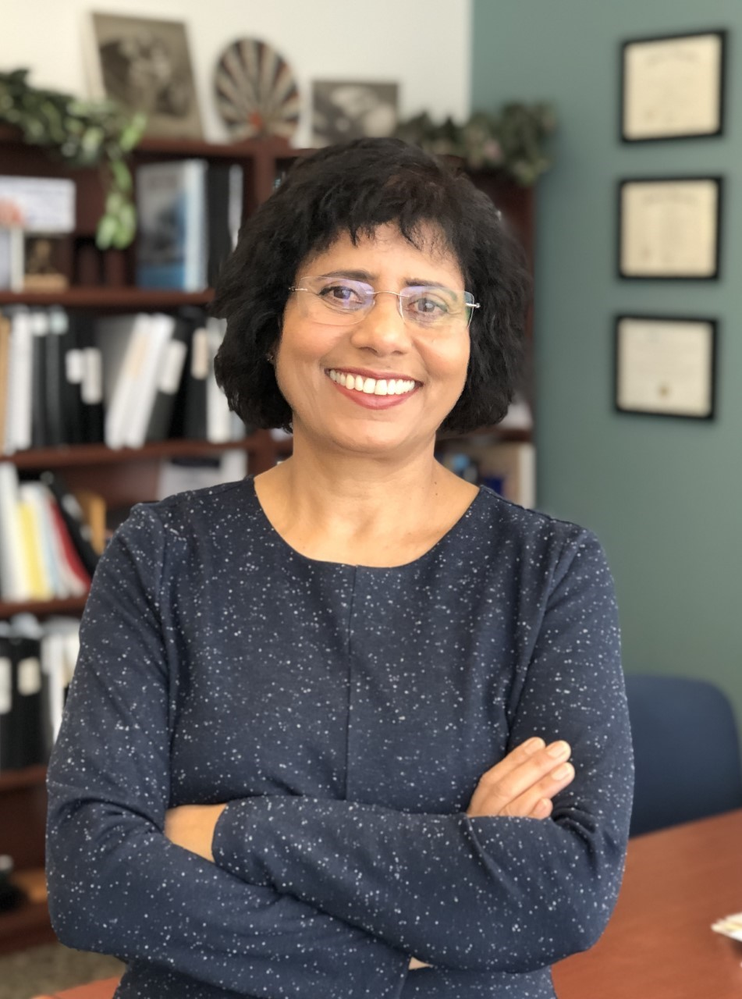
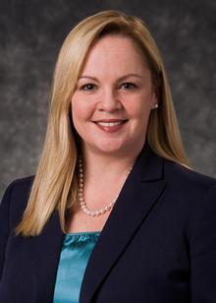
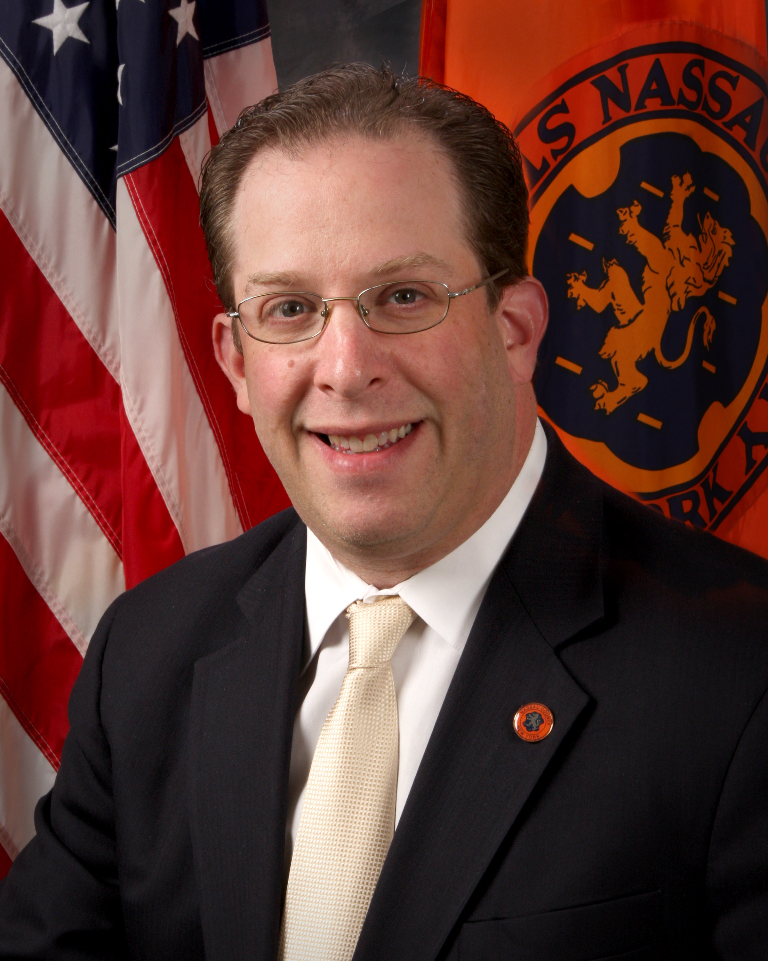
Presenters:
Dr. Indu Gupta, MD, MPH, MA, FACP
Commissioner of Health
Onondaga County
Dr. Elizabeth Whalen, MD, MPH
Commissioner of Health
Albany County
Dr. Lawrence Eisenstein, MD, MPH, FACP
Commissioner of Health
Nassau County

Slide 4
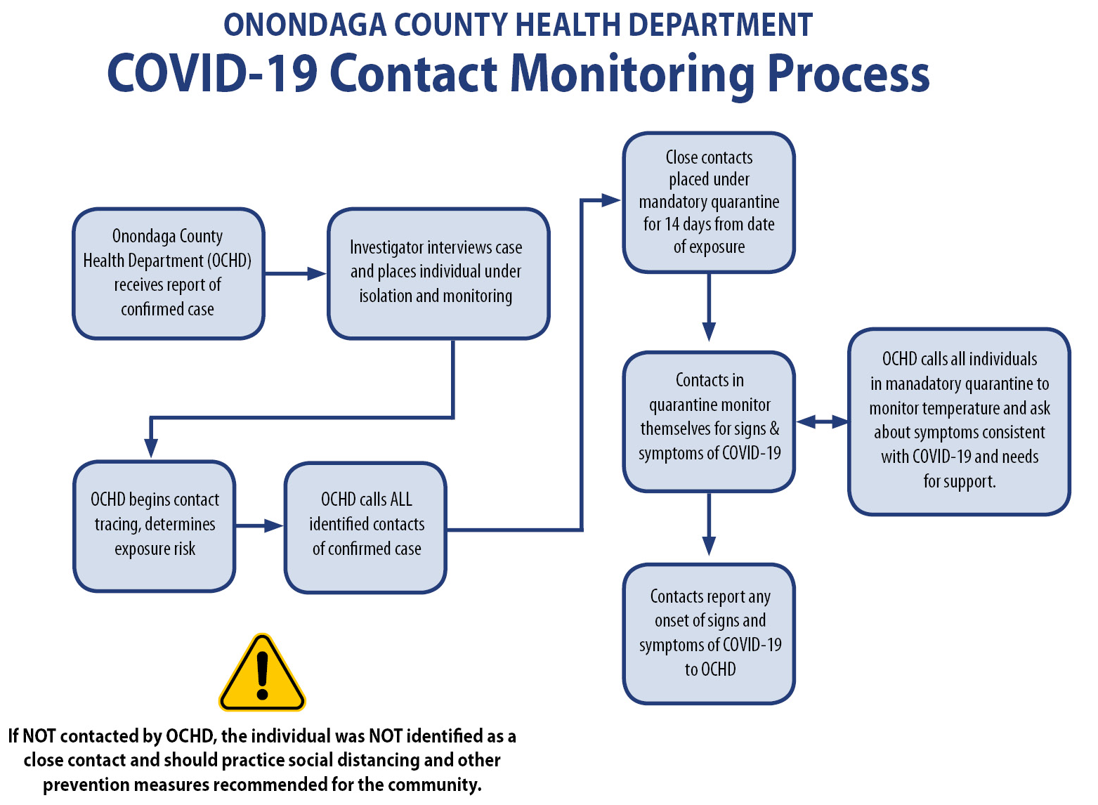

Slide 5
Thank you for joining the webinar today!

