Slide 1

Dutchess County
Innovative Approaches to assisting individuals experiencing homelessness

Slide 2


Activities presented were only possible because of trusting collaborative relationships built over time.
This allows for freedom of discussion, disagreement and exchange of ideas
Coordinating Criminal Justice Council

Slide 3
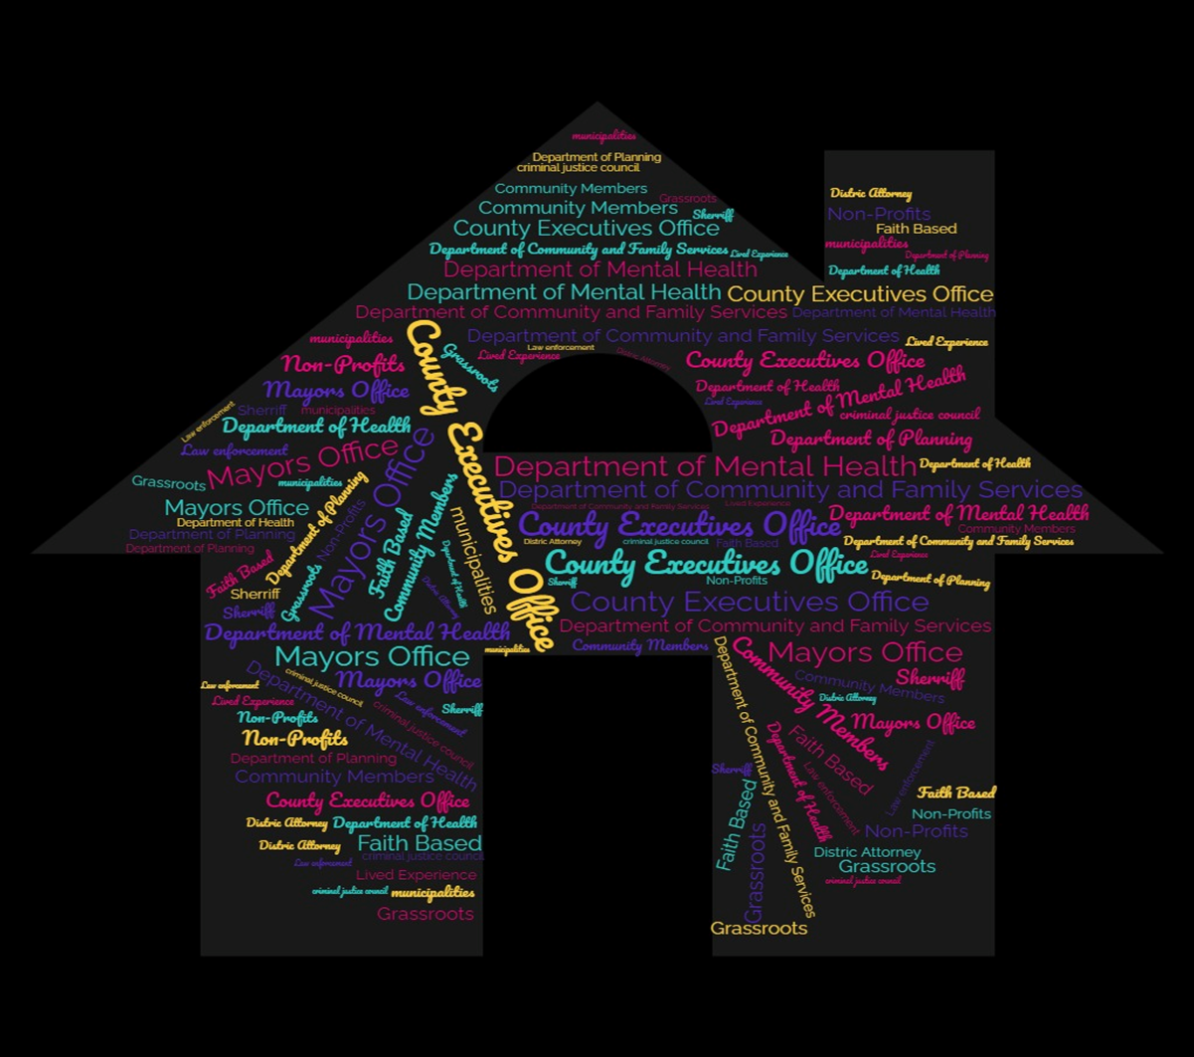
Notes:
**Coordinating Criminal Justice Council
County Executives office
Department of Community and Gamily Services
Department of Mental Health
Department of Health
Planning Department
Sherriff's Office
Other municipalities
Law enforcement
Probation
Public Defender
District Attorney
People with lived experiences
Community organization
Community members
Community providers
Grassroots organizations
Faith based communities

Slide 4


Law Enforcement Assisted Diversion (LEAD)
Intensive- street based- case management
for people with VERY complex needs who just can’t be reached by existing systems and interventions.

Slide 5
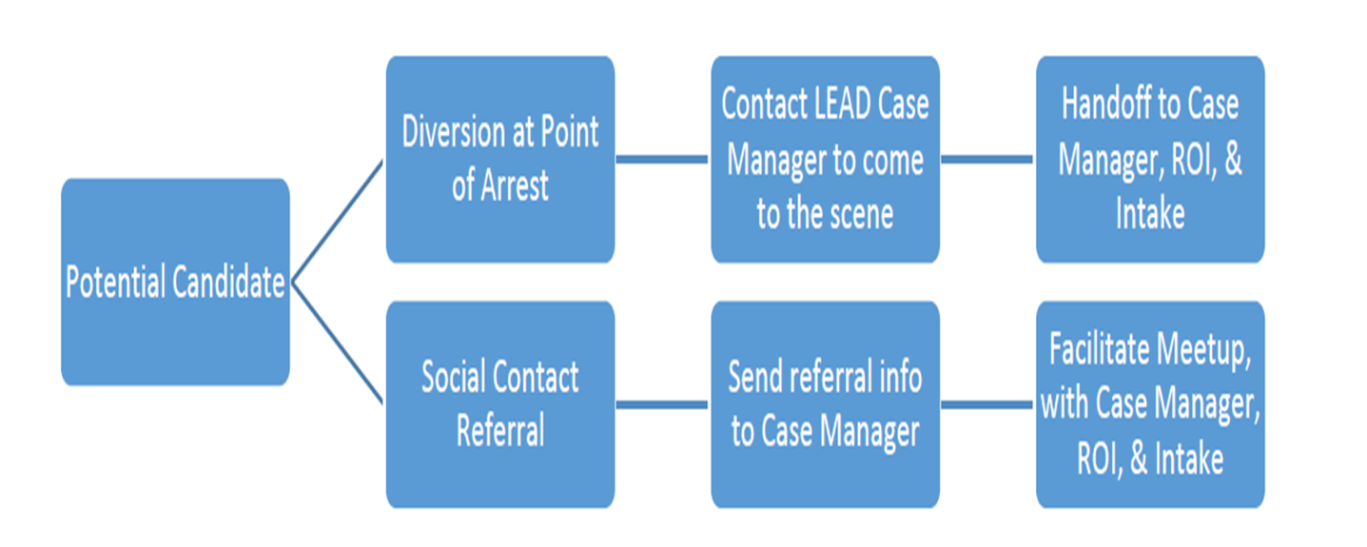
How LEAD Works
Notes:
Who does LEAD serve
People who live with unmanaged behavioral health needs
Deep experiences of complex trauma
Intellectual and developmental disabilities
Persistent poverty and often lifelong experiences of punishment, failure and marginalization
THE PEOPLE WHO ARE NOT SERVED BY OFFICE-BASED, APPOINTMENT BASED, TIME LIMITED CARE

Slide 6

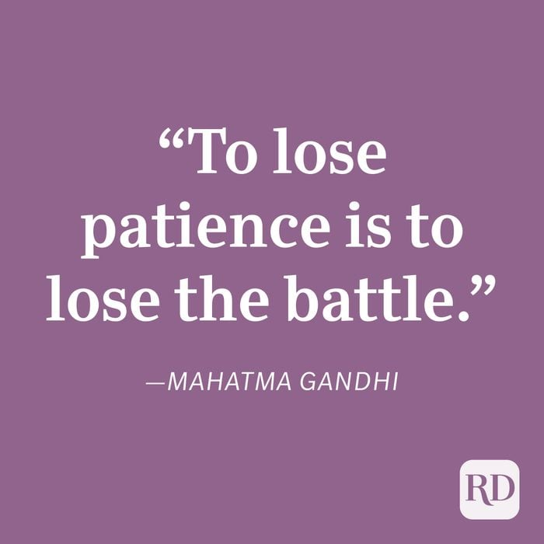
LEAD intervention takes time
Measure success carefully
Micro-person; Macro- system
Notes:
LEAD isn’t “owned” by any one stakeholder or agency.
Multi-agency Policy Coordinating Group (PCG) provides collective governance and joint decision-making.
City of Poughkeepsie Administrator
Public defender
District Attorney
City of Poughkeepsie Police
Provider agency
County executive’s office
Sherriff’s office
Operational Work Group (OWG) includes all operational partners; together, they support coordination and case reviews.
Community Leadership Team (CLT) provides community input, education, and transparency.

Slide 7

This isn’t that…it’s different
Notes:
What LEAD is not Not
self-referral to treatment via law enforcement (PAARI, Angel Program, Hope Not Handcuffs)
Not diversion to treatment (PAARI, Quick Response Team)
Not overdose response (Drug Abuse Response Team Stop-Triage-Engage-Educate-Rehabilitate)
Not a crisis/co-responder model (Mobile Crisis, CIT, Co-Responders)
Not a therapeutic court (drug court, community court, mental health court, homelessness court, veterans’ court)
Not an alternative to 911 response (CAHOOTS)

Slide 8
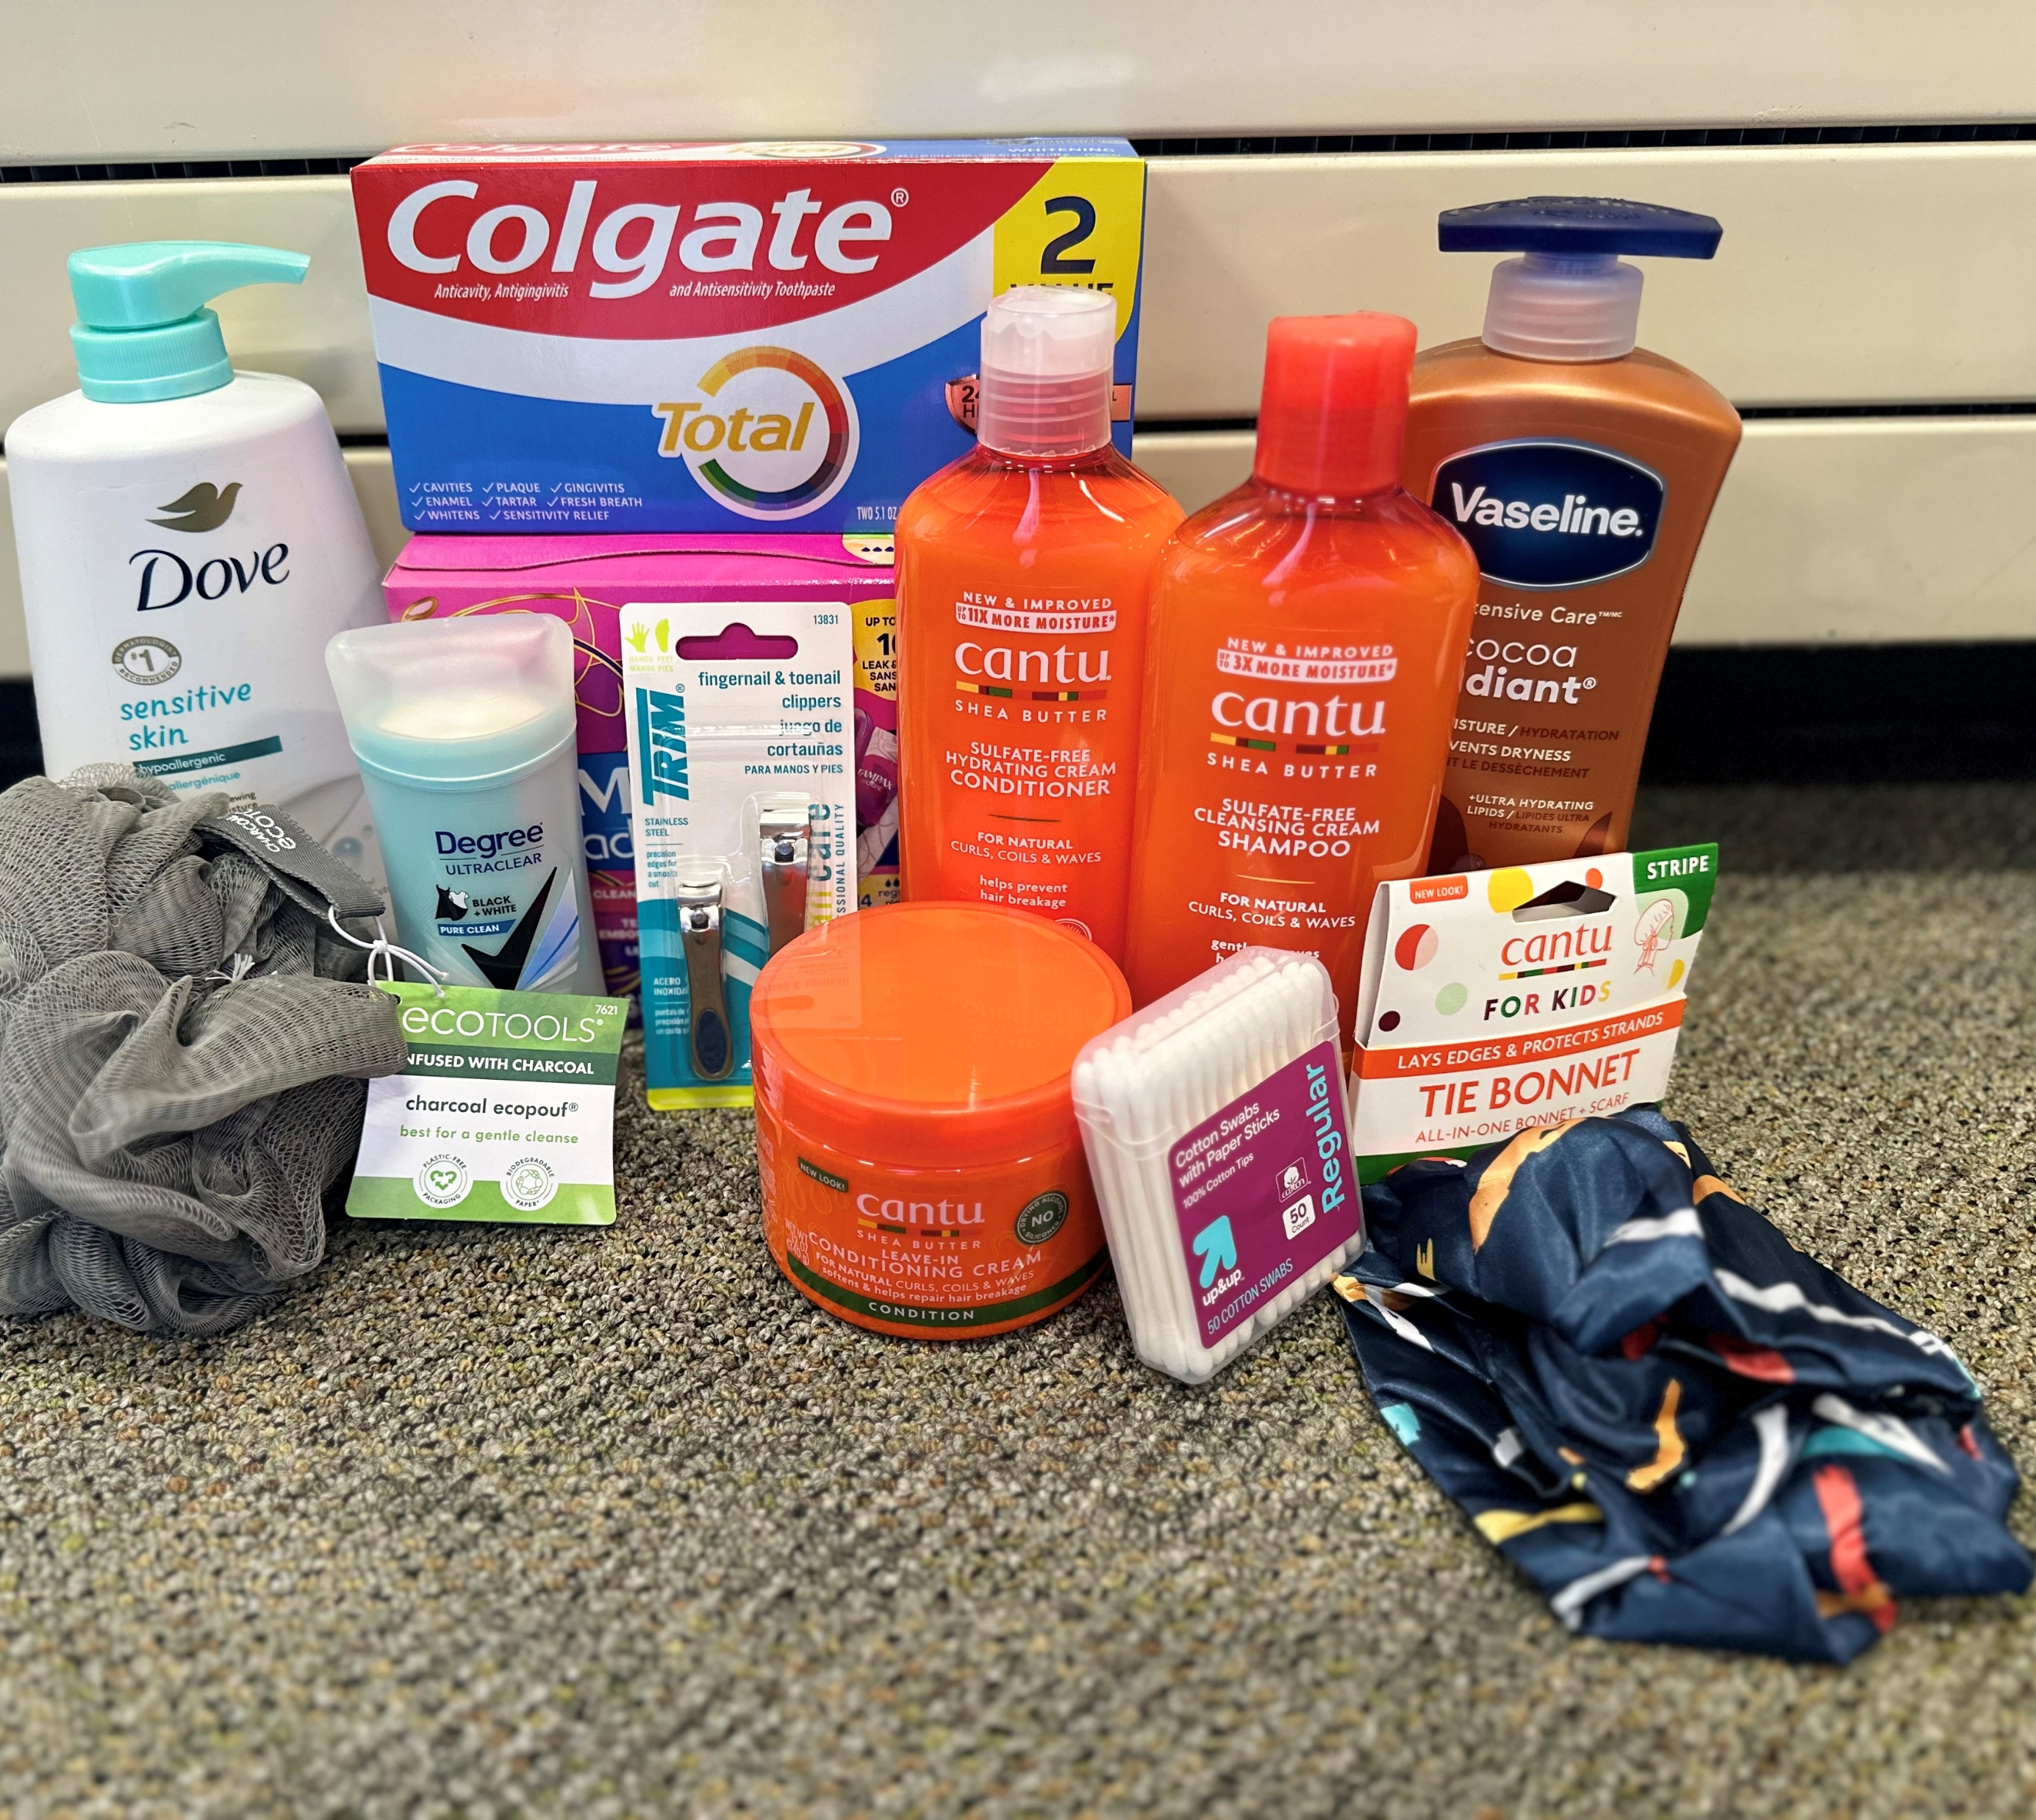
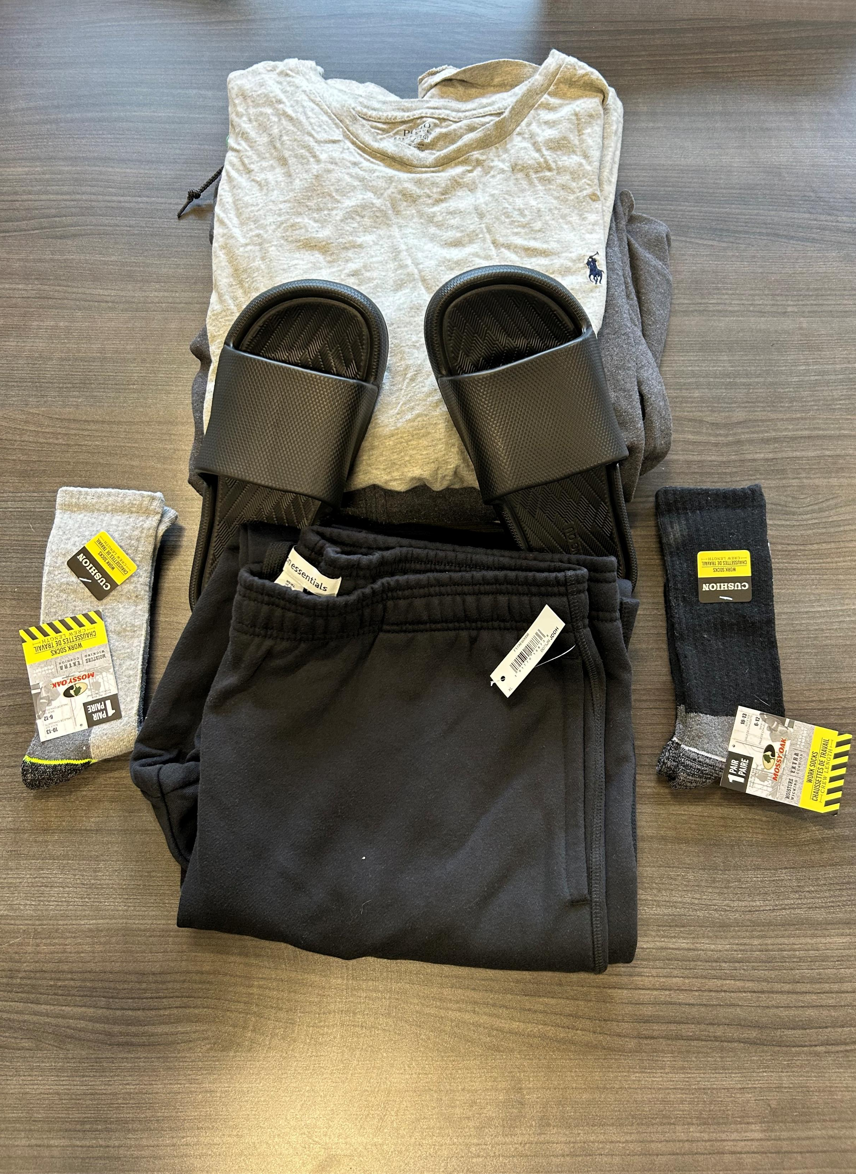
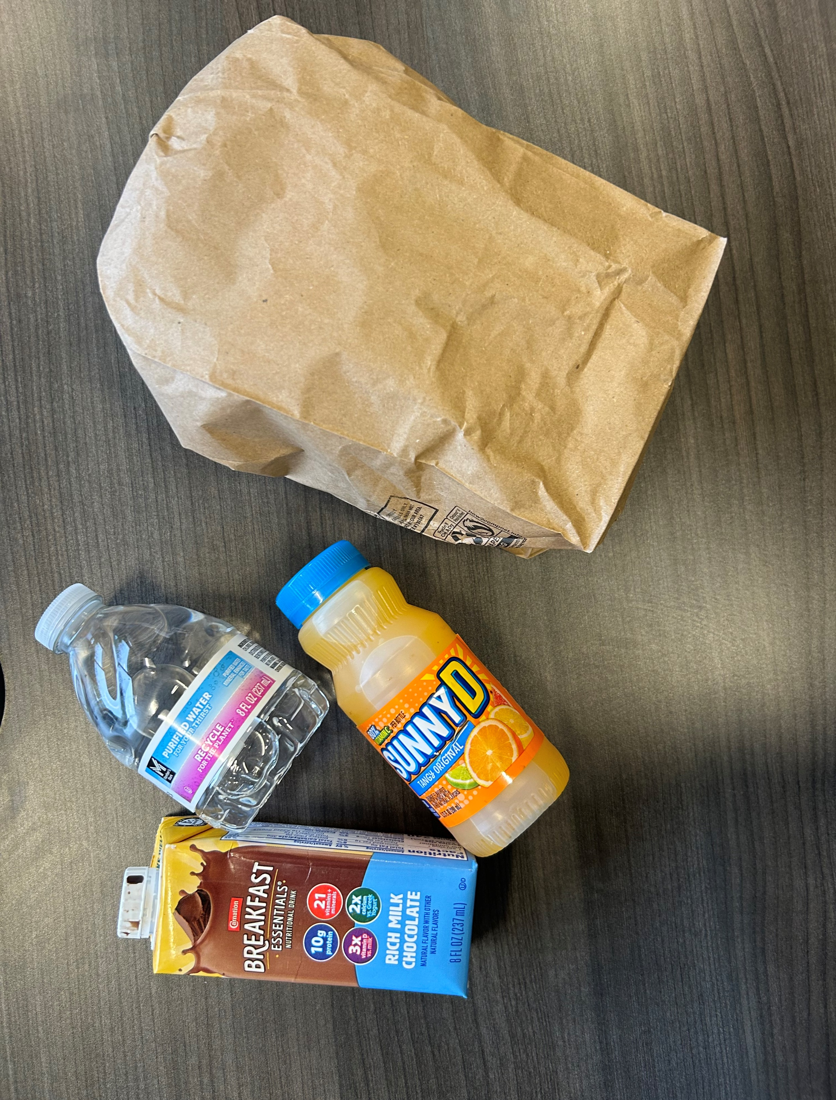
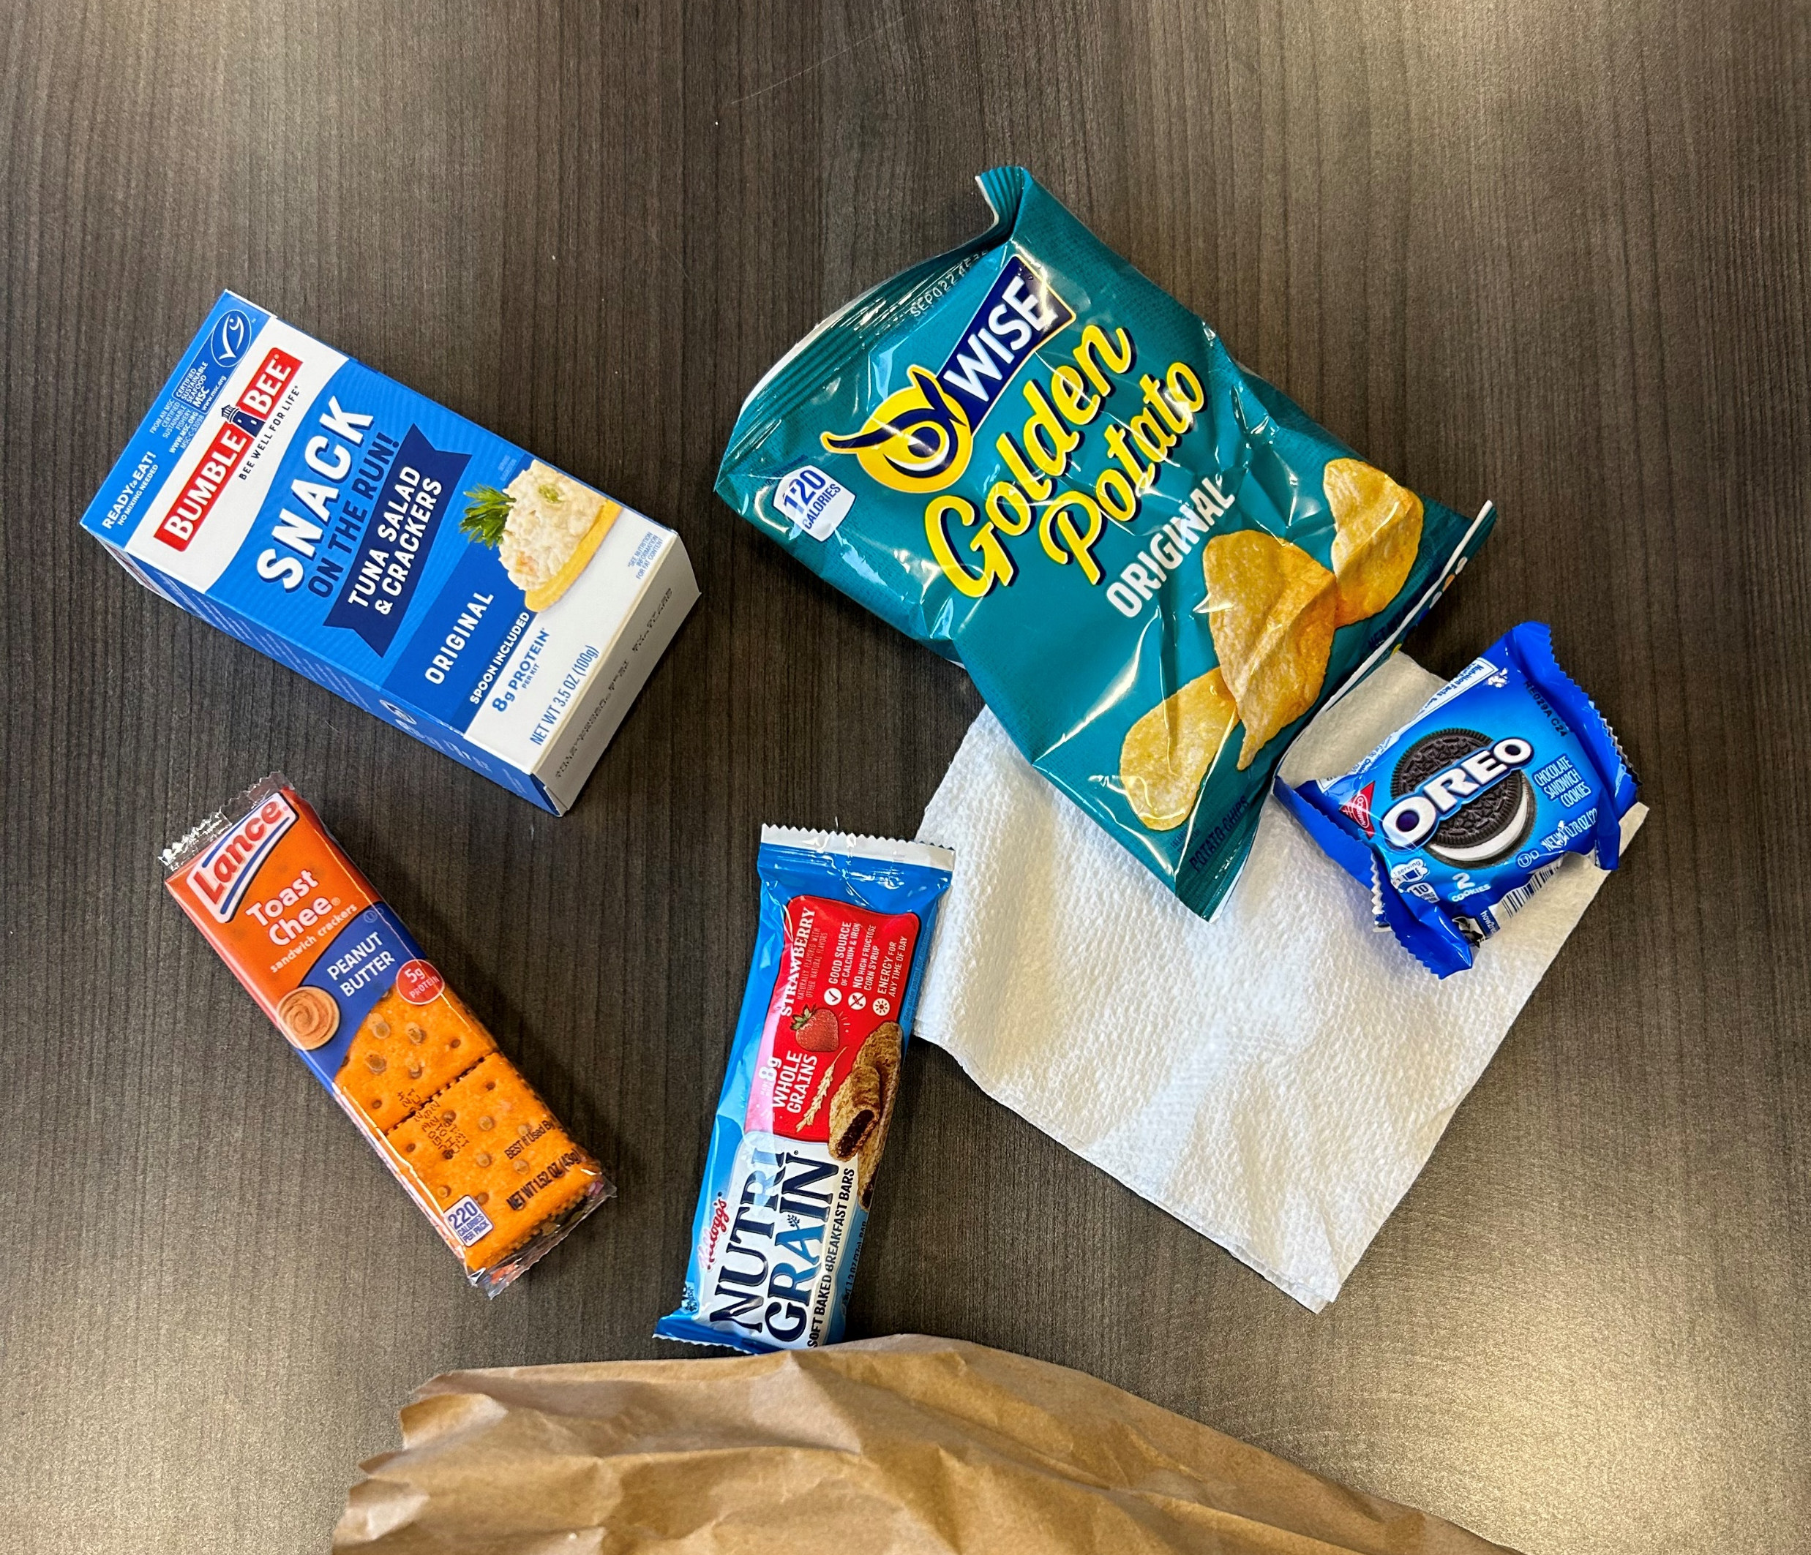
Success!
A 58 Year old participant was street homeless for 10+ years, displaying and verbalizing skepticism of LEAD case management and shown mistrust of local agencies has been able to work with MHA housing program and attend regular weekly counseling meetings and adhere to the regulations of the housing agreement for 4 months. He has challenged himself and addressed his concerns in a manner that is respectful and therefore allowed him to maintain his housing during moments of frustration and uncertainty

Slide 9

LEAD Outcomes
42 participants enrolled
76% have avoided incarceration
9 have obtained stable, long term housing
7 were at risk of homelessness/eviction and have been able to maintain housing with LEAD assistance
15 have entered MH and/or SUD treatment

Slide 10

Oxford House- the model
Notes:
Homes are leased in nice neighborhoods with access to recovery supports and transportation
Individuals are interviewed by other Oxford House residents to see if they will be a good fit
Peer run, democratically run-
President
Treasurer
Comptroller
Secretary
Coordinator

Slide 11
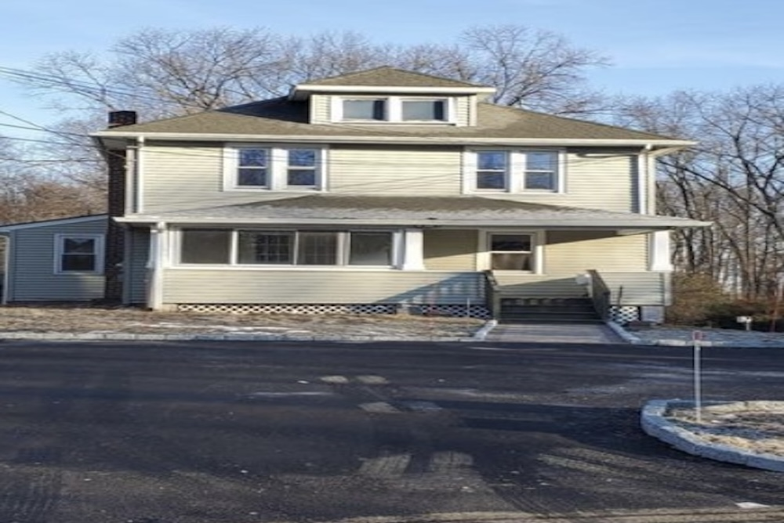
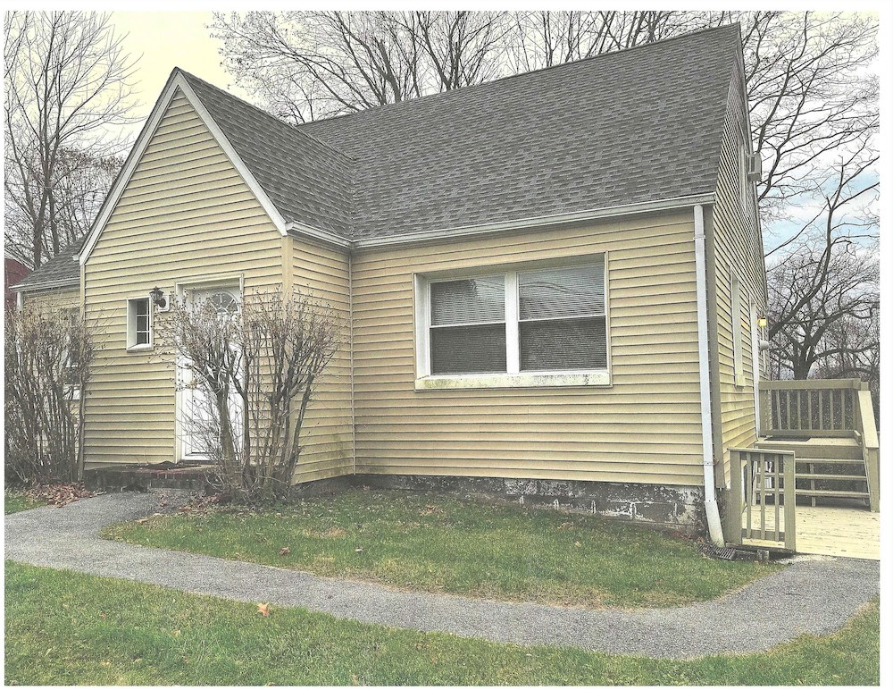
Oxford House in Dutchess County
“I came straight from jail and I love this house! I’m serious about my recovery and I really want this to work and I love that my daughter can spend weekends with me.”
-Erica
“I never knew places like this were here for people like me” -Alex
“Man this house really worked with me. I came in with nothing and today I have a good job and I am current on my EEE (equal expense shared). They really worked with me until I got my job situated. I’m very grateful!“
- Rashoun
Notes:
# of people housed
Locations of houses

Slide 12

HOT (Homeless Outreach Teams)

Slide 13

Housing Trust Fund

Slide 14

Dutchess County Continuum of Care (DCC0C)

Slide 15
Continuum of care
Consortium of non-profit, government, and community members committed to ending homelessness
According to HUD, a CoC is “a community plan to organize and deliver housing and services to meet the specific needs of people who are homeless as they move to stable housing and maximize self-sufficiency"
Rehouse homeless individuals and families while minimizing trauma

Slide 16
DCCoC Partners
Local Government Agencies
Mental Health Providers
Substance Use Providers
Outreach Providers
Veteran Providers
Housing Providers
Food Insecurity Agencies
Case Management
Persons with Lived Experience

Slide 17

Continuum of care
Why is it important for local leaders to participate on a CoC?
This Photo by Unknown Author is licensed under CC BY-SA

Slide 18
Local Leaders
Have a voice in how the CoC prioritizes “bonus” funding
Prioritize bonus funding to high-need areas
CoC Funding Areas
Permanent supportive housing
Rapid Rehousing
Support Services

Slide 19
DCCoC Funding

Slide 20
Homeless outreach team (hot) Committee

Slide 21
What is the HOT Committee
  Established in January 2024
  To better address the needs of our homeless population
  Solicit input from multi-disciplinary members
  To coordinate homeless outreach efforts across agencies
  To eliminate duplication of services
  Identify the lead agency

Slide 22
HOT Committee Partners
(Memorandum of Understanding )
Local Government Agencies
Mental Health Providers
Substance Use Providers
Outreach Providers
Veteran Providers
Housing Providers

Slide 23
Housing Outreach Team (HOT)
Multi-Disciplinary Partners
Department of Community and Family Services (DCFS)
Adult Protective Services
Housing Unit
Department of Behavioral and Community Health (DBCH)
Law Enforcement Assisted Diversion Program (LEAD)
Single Point of Access (SPOA)
Mental Health America of Dutchess County
Mobile Crisis Intervention Program¹
People USA
Stabilization Center¹
HONOR’s
Safe Options Support (SOS) Critical Time Intervention (CTI): SOS-CTI
Hudson River Housing
Outreach program¹
¹ Funded in part by Dutchess County

Slide 24
Housing Outreach Team (HOT)
Multi-Disciplinary Partners
City of Poughkeepsie Police Department
Behavioral Evaluation and Assessment Team (Behavioral health and law enforcement outreach team)¹
Town of Poughkeepsie Police Department
Behavioral Evaluation and Assessment Team (Behavioral health and law enforcement outreach team)¹
Town of Hyde Park
Behavioral Evaluation and Assessment Team (Behavioral health and law enforcement outreach team)¹
City of Beacon Police Department
Enhancing Community Health Through Outreach (ECHO)
¹ Funded in part by Dutchess County

Slide 25

HOT COMMITTEE
Conduct bi-weekly multi-disciplinary case consultations to promote client success
Assistance in identifying client’s whereabouts
Safety considerations for outreach staff

Slide 26
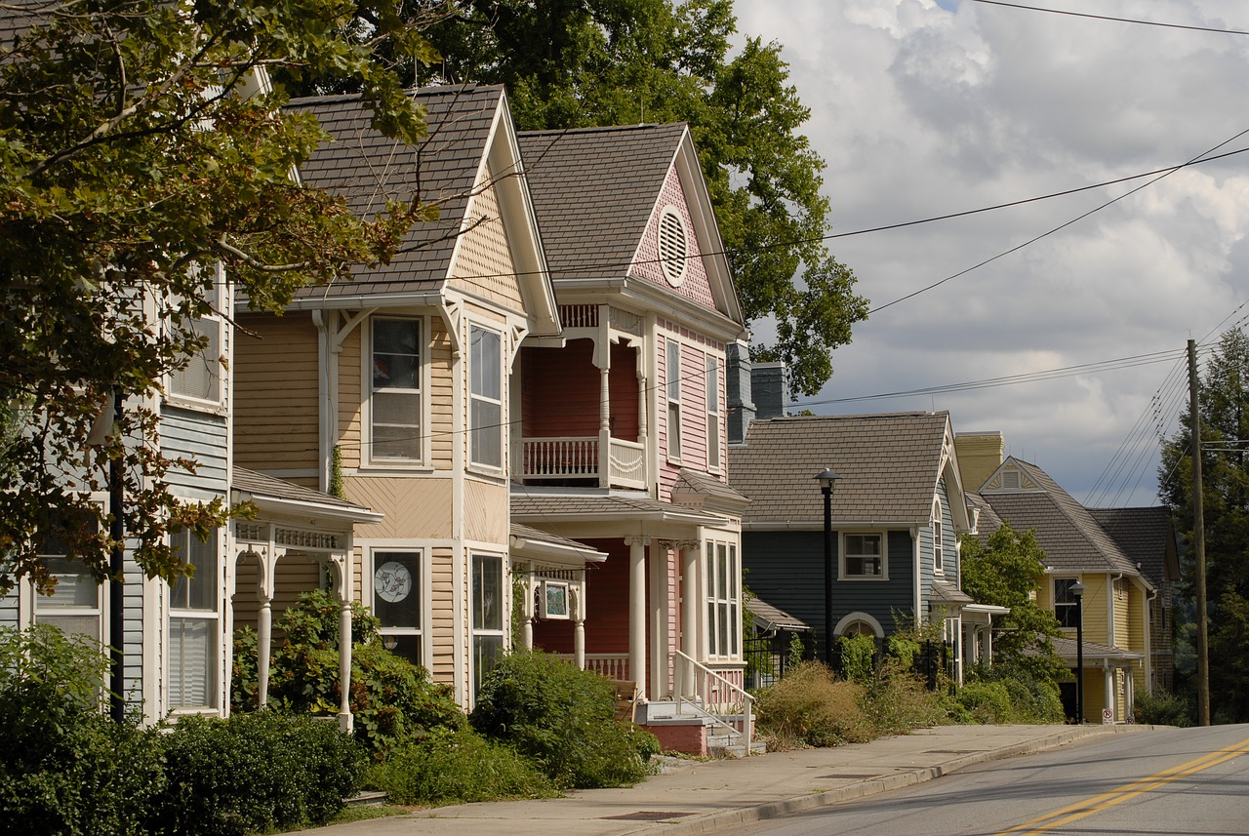


Dutchess County Housing Needs Assessment
2022

Slide 27
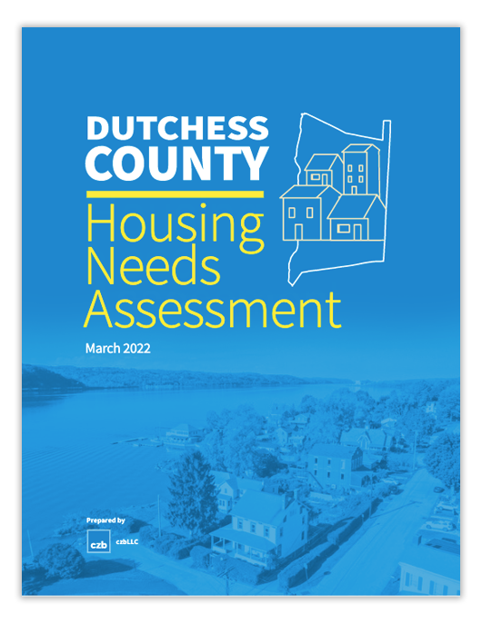
Project background
Project goals:
  Understand existing patterns of housing demand and need “both countywide and within the county”
  Anticipate future levels of housing demand and need as a basis for proactive planning
  Develop recommendations to guide public policy and public/private investments
Dutchess County Housing Needs Assessment | 2022
Notes:
Evaluate our demographic, economic and housing trends from the past 10-20 years to get a sense of what’s been shaping our current housing market
Project out to 2040 to help us determine future housing needs
Develop a strategy for action

Slide 28

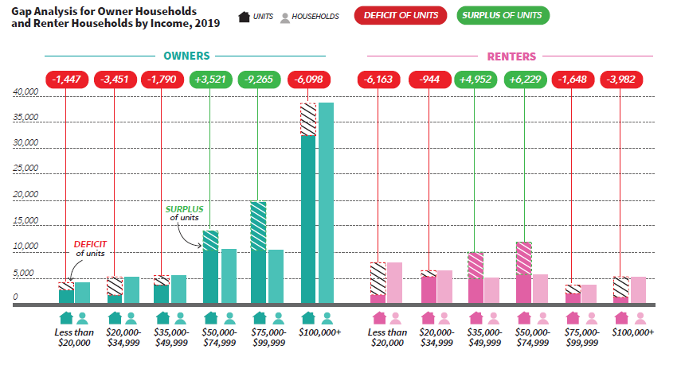
Gap analysis
Dutchess County Housing Needs Assessment | 2022
Notes:
We identified a variety of takeaways including slow population growth, but increasing households, albeit at smaller sizes; aging population, incomes lagging behind housing costs, cost burdens have impacted renters the most, and widening income gaps.
This Gap analysis = measures the difference between the number of units in a given price range and the number of households for whom the price range is affordable
Of note is a lack of units for both the lowest and highest incomes.
Low end isn’t unexpected, but the lack of housing on the high end is a new consideration.
As households with more purchasing power compete for a limited supply of units, they begin to reach down into the middle sectors of the market, which affects housing affordability at all levels.

Slide 29


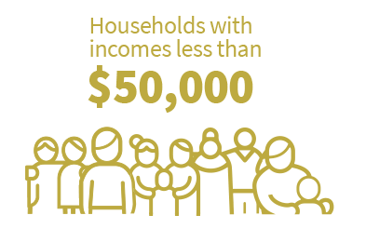
Strategy Recommendations
Establish goals to address housing needs
Greatest levels of need: renters earning under $50,000
Focus efforts on addressing the needs of this segment of the market
Dutchess County Housing Needs Assessment | 2022

Slide 30
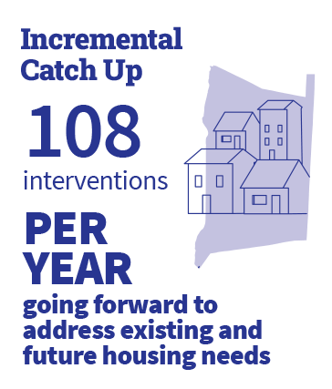
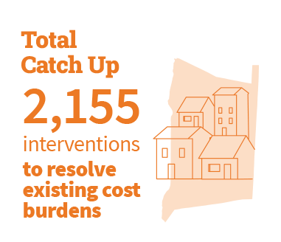
Strategy Recommendations
Establish goals to address housing needs
What will it take to address the current and anticipated future needs of this segment of the market?
Dutchess County Housing Needs Assessment | 2022
Notes:
The difference between the number of renting households earning less than $50,000 and the number of rentals that are affordable to those households
ABOVE what we already do
Construction AND other things

Slide 31









Strategy Recommendations
Develop and use a diverse toolkit
A Dutchess County Housing Trust Fund is recommended to support a diverse toolkit that can be adapted to meet the needs and conditions of jurisdictions across the county.
This toolkit may include:
Rehabilitation program for existing rentals
Local inclusionary policies
Subsidies for inclusive units in new, mixed-income developments
Local site identification and land use updates for new construction
Tax exemption policies
More housing vouchers
Subordinate mortgages to support affordable homeownership
Dutchess County Housing Needs Assessment | 2022
Notes:
A key takeaway from the trend analysis is that affordability challenges in Dutchess County resemble “death by a thousand cuts,” with a range of factors contributing to the cost pressures felt by today’s households. As there is no single cause for the current housing affordability pressures, there is also not a single solution.

Slide 32
Dutchess County Housing Trust Fund

Slide 33
Strategy Recommendations
Develop and use a diverse toolkit
Create a Dutchess County Housing Trust Fund to help pay for these additional interventions—and to leverage other public and private resources
Recommend $2 million per year
Dutchess County Housing Needs Assessment | 2022
Notes:
In 2022 Then County Executive Molinaro and the County Legislature invested $12.3 million for the establishment of a countywide Housing Trust Fund, using 9.3 million in American Rescue Plan (ARP) funds and an additional $3 million from general fund balance. That funding has since changed to all fund balance.

Slide 34

Purpose
nimble
quick and light in movement or action; agile
Dutchess County Housing Needs Assessment | 2022
Notes:
In 2022 Then County Executive Molinaro and the County Legislature invested $12.3 million for the establishment of a countywide Housing Trust Fund, using 9.3 million in American Rescue Plan (ARP) funds and an additional $3 million from general fund balance. That funding has since changed to all fund balance.

Slide 35
3 Programs | 10 Eligible Activities
Housing Creation and Preservation (HCP)
Infrastructure and Pre-Development Support (IPDS)
First-Time Homeownership (FTH)
New rental units via construction, rehab, adaptive re-use
Acquisition and/or rehab of occupied naturally-occurring affordable units
Acquisition-only
Preservation/rehab of existing units with expiring compliance periods
Expand/extend water/sewer infrastructure
GEIS to streamline municipally-supported projects
Zoning revisions to permit/streamline creation of units. Municipal match required.
Centralized administration of affordable units created via inclusionary zoning, density bonuses
Locally-sourced “soft-second” mortgage program for down payment and closing cost assistance
Construction/rehab to create homeownership opportunities (by non-profit entities)
Notes:
In 2022 Then County Executive Molinaro and the County Legislature invested $12.3 million for the establishment of a countywide Housing Trust Fund, using 9.3 million in American Rescue Plan (ARP) funds and an additional $3 million from general fund balance. That funding has since changed to all fund balance.

Slide 36
Housing Creation & Preservation Program
Funding Details
Required Affordability
At least 80% of a project’s HCP-funded units must target households at or below 60% AMI (Dutchess County)
Remainder (no more than 20%) may target households up to 80% AMI (Dutchess County)
compliance period (30 years)
HCP Investment
Minimum HCP subsidy is $10,000/unit
Maximum HCP subsidy is $175,000/unit
No maximum per project award level
Notes:
In 2022 Then County Executive Molinaro and the County Legislature invested $12.3 million for the establishment of a countywide Housing Trust Fund, using 9.3 million in American Rescue Plan (ARP) funds and an additional $3 million from general fund balance. That funding has since changed to all fund balance.

Slide 37
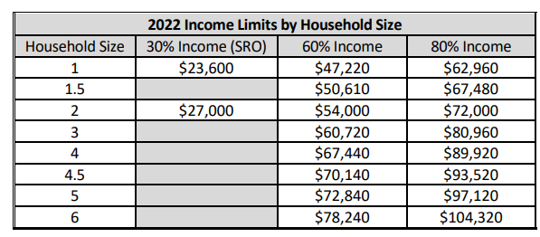
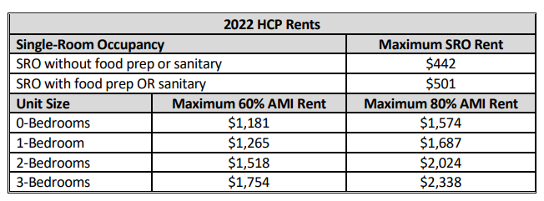
Housing Creation & Preservation Program Income & Rent limits
Notes:
In 2022 Then County Executive Molinaro and the County Legislature invested $12.3 million for the establishment of a countywide Housing Trust Fund, using 9.3 million in American Rescue Plan (ARP) funds and an additional $3 million from general fund balance. That funding has since changed to all fund balance.

Slide 38
1st Funding Round
  $9 million available in first round
  Opened on 10/13/22
  Applications were due on 11/30/22
  Received 8 applications totaling more than $22 million in funding requests
  Awarded 6 projects, which will result in 600+ units
Notes:
In 2022 Then County Executive Molinaro and the County Legislature invested $12.3 million for the establishment of a countywide Housing Trust Fund, using 9.3 million in American Rescue Plan (ARP) funds and an additional $3 million from general fund balance. That funding has since changed to all fund balance.

Slide 39
Challenges
Long Term (Permanent Funding)
Knowledge \ Experience
Scalability (Rural vs. Suburban vs. Urban)
Development Approval Process
Community Support
Notes:
In 2022 Then County Executive Molinaro and the County Legislature invested $12.3 million for the establishment of a countywide Housing Trust Fund, using 9.3 million in American Rescue Plan (ARP) funds and an additional $3 million from general fund balance. That funding has since changed to all fund balance.

Slide 40

Questions?

Slide 41
Contact us!
      Eoin Wrafter, AICP, Commissioner, Planning and Development
      ewrafter@dutchessny.gov (845) 486-3600
      Christie Bonomo-Gose, LMSW, Director of Adult Services, Department of Community & Family Services
      Christie.Bonomo-Gose@dfa.state.ny.us (845) 486-3026
      Jean-Marie Niebuhr, LCSW-R Commissioner, Department of Mental Health
      jmniebuhr@dutchessny.gov (845)486-3791

