Slide 1
NYSAC FALL 2024 Seminar
BUILDING CONSENSES IN POLITICAL ENVIRONMENTS
Collaborative Governing Program Co-Founder:
M. Bernadette Tracy, Ed.D
NYS Dispute Resolution Association
Collaborative Governing Program Co-Founder:
Niki Lee Rowe, LMHC NYS Dispute Resolution Association
A
T
S

Slide 2
A REPUBLIC
A form of government in which the people hold the power, and democratically elect representatives to exercise that power.
Once elected the representatives join to do the will of the people they collectively represent.

Slide 3
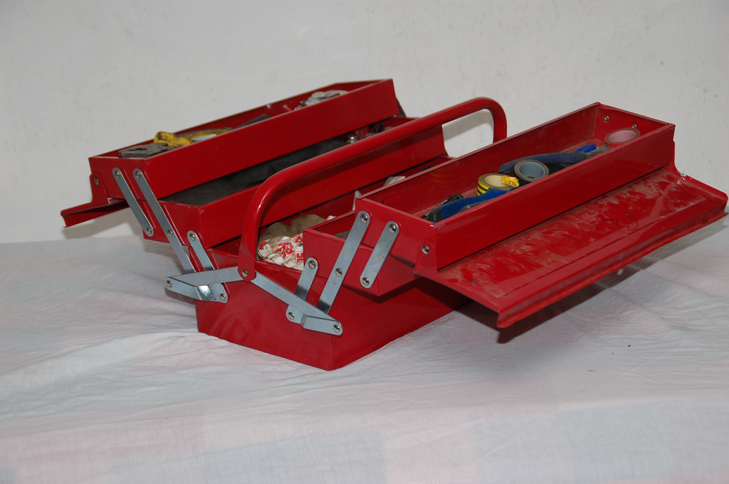
WHY
COLLABORATIVE
GOVERNING!!!
Those given the legitimate authority to govern -
work cooperatively across party lines on complex problems to produce sustainable, value-added policies for the communities they collectively serve.
A
T
S
Notes:
Political leadership at any level is filled with contradictory imperatives: the need to fight for equity and a fair share for your people; the need to work together with others to get things done that can’t be done alone; the desire to do what is morally right; and the insistent call to be pragmatic and do that which is doable. Competitive, cooperative, moral, and practical impulses tug at each other.
A government in which the people democratically elect representatives who, once officially sworn in, join to do the business of the people who elected them.
You are collective body.

Slide 4
Session Expectations
Yours
Facilitators’
Full Participation
Mutual Respect
Willingness to Consider Different Points of View
Open Mind to New Ideas
Having Fun
A
T
S
Notes:
Get a few from the group - Highlight ours and move on

Slide 5

CGP Workshop Goal
Goal: Participants Gain Awareness of
Fundamental Concepts & Skills
Objectives: Participants will be able to:
    Discuss the value of Governing Collaboratively
    State the benefits of Interest Based Negotiations
    Use “Consensus-Building Communication Skills”
A
T
S
Notes:
Note: Today we offer a few of the basic skills involved with Interest Based Collaboration.
You will Own the ability to use a few of these skills that will allow you to strategize when to use them or not use them for mutual gain, and for knowing when mutual gain is not possible or appropriate. These are tools for your toolbox.

Slide 6
Positions to Interests Demo
  A VENDOR ONLY HAS SIX ORANGES LEFT!
  TWO GOOD CUSTOMERS EACH WANT ALL SIX OF THE ORANGES.
  THE VENDOR DOESN’T WANT TO ALIENATE EITHER ONE SO SHE ASKS THEM TO WORK IT OUT AND LET HER KNOW TO WHICH OF THEM SHE SHOULD SELL THE ORANGES.
  GUESS WHO WINS?
A
T
S
Notes:
Bring 6 oranges 10 Min.
Have the recipes for Marmalade and Orange Punch written out on a 3x5 card
Do not give hints – let the ‘volunteers’ work it out
After 2 minutes of bargaining, stop the action and hand each participant the recipe for his/her interest
It becomes obvious they can both have their interest satisfied by sharing all six oranges. This is the essence of Interest-based negotiation.

Slide 7



Parable of the Oranges
Notes:
I want / need all six oranges: Both parties POSITIONS
BUT
What will satisfy their NEEDS?

Slide 8
POSITIONS TO INTERESTS
Needs Formula
WHAT’S A POSITION
WHAT’S AN INTEREST
WANT
What Do I Want?
NEED
Is Under The Want
impact?
What Difference Will It Make?
A
T
S
Notes:
Political leadership at any level is filled with contradictory imperatives: the need to fight for equity and a fair share for your people; the need to work together with others to get things done that can’t be done alone; the desire to do what is morally right; and the insistent call to be pragmatic and do that which is doable. Competitive, cooperative, moral, and practical impulses tug at each other.

Slide 9
Transforming Position-Based Interactions
DEFENSIVE
Empowerment Shifts
PROACTIVE
ATTACKING
ACCUSING
THREATENING
BLOCKING
PROPOSING
PROCESSING
QUESTIONING
CLARIFYING
SELF-ABSORBED
Collaborative Shifts
RESPONSIVE
BLAMING
DEFENDING
GUILT-TRIPPING
COMPLAINING
LISTENING
BUILDING
AGREE/DISAGREEING
CHECKING IN SUMMARIZING
A
T
S
Notes:
To surface hidden interests we must move from self-absorption in our own point of view to empathic connection to others’ perspectives. Only then can we begin interest-based problem-solving.
How? (1) Employ the Strategies we just reviewed; (2) Use the Communication Skills we are about to learn to execute those strategies
Disagreement is an opportunity for creating beneficial outcomes.

Slide 10
Listening
First Critical Skill for
Mutual Benefit
Notes:
Attentiveness/LISTEN
The disposition that inspires us to listen to what’s outside as well as inside us.
Everybody knows that listening is important. And yet, even sensitive, ‘good’ and skilled people struggle to listen, especially when confronted with distractions and unpleasantness or discomfort. Listening requires focus. Most of us are able to focus only when we are interested, when the benefits of doing so are easily evident and when we don’t feel threatened. Even then we are usually more attentive to what our response is going to be. The best argument for being attentive is that we really know very little about the other’s reasons for their position. What we think we know is usually erroneous anyway. This makes the disposition of humility a strategically necessary stance if we are to learn anything really new. (We must be in a stance of not knowing – curiosity.)
HO 1:
Have participants take an assessment form from the hand outs in their packets.
Give 2 min. to complete
This is for you only – Be honest with yourself. Won’t be passed in or shared. A Pre-test that you can use to assess how you, personally, are improving your listening ability.

Slide 11

HOW DO YOU LISTEN?
be
Notes:
How do you LISTEN?
Be SILENT
Knowledge focus: Curious and attentive silence offers the opportunity for the other to speak and let out their frustrations.
LISTEN AND SILENT are made up of the same letters. When you are truly listening you offer silence and attention.
Facilitator asks:
How do you know someone is really listening to you?
What difference does it make to you when you know they are listening?
What does it mean to you when you are feeling heard?
When you are truly listening, what might tell you the other person is ALSO listening?
How might you know they are paying attention?
Knowledge Focus
YOUR STANCE: Stop – Breathe – Listen - Truly Hear
Pay attention – DO NOT INTERRUPT
Stop whatever you are doing
Look at and listen to them
If you are thinking of your response, you are not listening
Stay Neutral
It is their feelings that are important here
Hear their feelings - Just listen
When you find their feeling, you will find the person.

Slide 12
Listening Habits
Not Paying Attention (distracted) [ ]
Pseudo-Listening (pretending) [ ]
Not Hearing (facts w/out feelings) [ ]
Rehearsing (practicing what to say next) [ ]
Interrupting (cutting-off the speaker) [ ]
Hearing What is Expected (hearing what you want) [ ]
Feeling Defensive (assuming speaker’s intent) [ ]
Listening for Disagreement (waiting for a chance to attack) [ ]
A
T
S
Notes:
Make a Handout of this slide
Instruct participants to select the listening pitfall with which they can identify the most.
Have them place a 1 next to the behavior with which they most identify, a 2 next to the next most likely behavior of theirs, a 3 next to the next most likely, and a 4 next to the next in line
Get participants engaged in referencing circumstances when they fall into their top major listening trap with a partner

Slide 13
The Art of Listening
Listening - the act of attending to the speaker in a way that helps the listener receive both spoken and unspoken messages.
Active Listening - gives both the speaker and listener direct feedback that allows them to loop messages for increased clarity.
Collaborative Listening – Listener’s attention is on understanding the speaker’s implied and/or unspoken concerns and interests from his/her perspective.
ATTENTIVE CURIOSITY
A
T
S
Notes:
Possibly do examples: most may think they understand active listening – but – may actually not.
How is active listening different than collaborative listening? “
What difference would it make if someone listened to you to truly understand you?”
How would you feel?
Open up for examples

Slide 14
Collaborative Listening is PRESENCE!
When you ‘hear’ what people are feeling under their words, you can respond in tune with their message. (Attuning)
When your response is in sync with their message, using their words, it sounds familiar and in harmony. (Resonating)
3. When you use their words, it opens the door to
their hearing yours. (Building Trust)
Notes:
1. Every thought begins with an emotion. Your gut (physical body) actually prescribes what your brain thinks.
2. Language creates change. Listen and use their language (I see, I hear, I feel, I think etc.)
3. Listen to hear if they are now able to respond to your interests. If not ask another interest gathering question.
It’s smart to let people know you understand where they are coming from, even if you do not agree.

Slide 15
Key Collaboration Strategies
Don’t Bargain Over Positions *
Do Separate the People from the Issue *
3. Do Listen to Understand the vested
Interests* (Use the Needs Formula)
4. Do Construct Common Interest Statement
(Combine the interests)
Ury & Fisher, Getting to Yes*
A
T
S
Notes:
Go through the list, stopping to identify a situation that demonstrates the strategy. E.G. 10 Min
“No Overtime Pay” counter “Up to 20 hours overtime pay per quarter or we have a problem.” vs. What’s up? Overtime has never been an issue before. So, if we did have overtime pay what difference would it make?
“She has been harping on flexible scheduling forever.” vs. “So, if flexible scheduling was in place what difference would it make?”
“For 40 years we only have hired people who can work 9 to 5, and that’s the way it will be for the next 40 years.” vs “What difference will it make if we have flexible work schedules in place?
Combining the interests into one common statement. (example: So, if we have a conversation where we find a way so that you can you make your marmalade and I can make my juice will that be productive?
Reference existing policy, law, guidelines, precedents, etc.
Before you start, prepare yourself by understanding the worst-case scenario outcome if no agreement is reached.
“Engage the brain before engaging the mouth.”
“Winning” means somebody loses and has a need to ‘get even’.

Slide 16
Interest-based Strategies
Practice
Separate the People from the Issue
Speaker A: We need to set this aside for another time.
Speaker B: You are just delaying like you always do.
OR….
How will setting it aside help the current situation?
Notes:
Pair them: let them come up with the appropriate response.
Then R/V/A (Recognize, Validate, Express Appreciation)
Answer: Difference questions: How will setting it aside help the current situation?

Slide 17
Interest-based Strategies
Practice
Do Listen to Understand the vested
Interests (Needs Formula)
Speaker A: It will give us time to get the cost projections.
Speaker B: So, you’re putting costs before the people being
impacted.
OR:
What difference will it make to have cost projections before responding to the request for a public meeting ?
Notes:
Ask participants to comment on the respondent’s comment and suggest an “instead”. After two or three comment, click “OR”

Slide 18
GETTING TO INTERESTS
Speaker A: It will lessen our exposure to negative criticism. We’ll be prepared to show we have done due diligence.
Speaker B: I understand. But we need to respond in a timely manner so that they know we are listening to them.

Slide 19

Create Common Interest
Statement
Inclusive of both Parties’ Interests
Notes:
Let the tables come up with a common goal statement.
Then ask each table table to share theirs.
Acknowledge, Validate/Improve, Express Appreciation for sharing
Example: How to institute flexible hours, while preserving the current 8am to 5pm work schedule.

Slide 20
COMMON INTEREST STATEMENT
So, if we can agree on a way to set a timely date for the meeting with the assurance we will have the data you think we need can we take this discussion forward?

Slide 21
Group Discussion
A Grant for $10 million for comprehensive integrated outpatient treatment programs to address opioid use disorder is now available to 20 providers across NY counties.
Two types of responses began flooding the Counties phones and social media pages almost immediately:
Say NO, to any more drug treatment centers in our community. NIMBY!
Say YES, we need to confront this growing threat in our community. The hard truth is we need clinics everywhere, and we need them now….
ISSUE: SHOULD WE SEEK THE GRANT?

Slide 22
Key Collaboration Strategies
Don’t Bargain Over Positions *
Do Separate the People from the Issue *
3. Do Listen to Understand the vested
Interests* (Use the Needs Formula)
4. Do Construct Common Interest Statement
(Combine the interests)
Ury & Fisher, Getting to Yes*
A
T
S
Notes:
Go through the list, stopping to identify a situation that demonstrates the strategy. E.G. 10 Min
“No Overtime Pay” counter “Up to 20 hours overtime pay per quarter or we have a problem.” vs. What’s up? Overtime has never been an issue before. So, if we did have overtime pay what difference would it make?
“She has been harping on flexible scheduling forever.” vs. “So, if flexible scheduling was in place what difference would it make?”
“For 40 years we only have hired people who can work 9 to 5, and that’s the way it will be for the next 40 years.” vs “What difference will it make if we have flexible work schedules in place?
Combining the interests into one common statement. (example: So, if we have a conversation where we find a way so that you can you make your marmalade and I can make my juice will that be productive?
Reference existing policy, law, guidelines, precedents, etc.
Before you start, prepare yourself by understanding the worst-case scenario outcome if no agreement is reached.
“Engage the brain before engaging the mouth.”
“Winning” means somebody loses and has a need to ‘get even’.

Slide 23
Debrief
Group Discussion
Notes:
Discuss the process just experienced.

Slide 24
Workshop Assessment
What worked well?
Suggestions for
Improvement?
Other Comments?
A
T
S
Notes:
Capture responses on flip charts.

Slide 25
THANK YOU!!!
For further information on the
Collaborative Governing Program
Contact: NYSDRA
New York State Dispute Resolution Assoc. Inc.
Theresa Hobbs, Executive Director
518-687-2240 info@nysdra.org
website: nsdra.org
A
T
S

